Slide 1
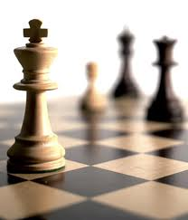


人工智能
罗平 luop@ict.ac.cn

Slide 2
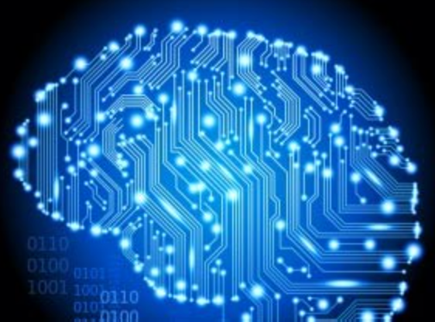
Knowledge 1

Slide 3
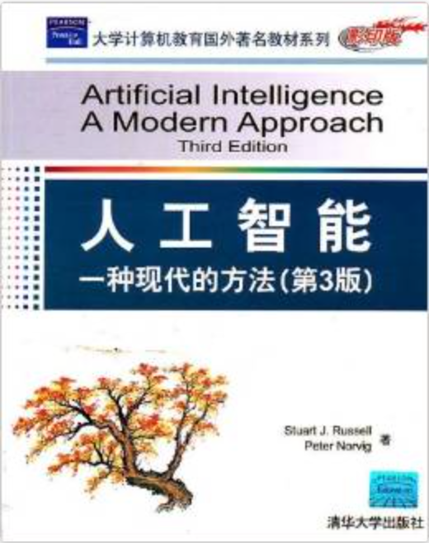
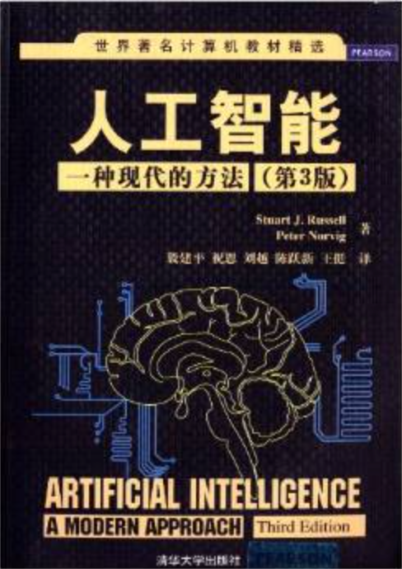
教材
http://www.ai-fundamental.com/
Materials on Knowledge
课程第二部分：
台湾大学 于天立教授 “人工智慧”课程
链接: http://pan.baidu.com/s/1miec9jM 密码: 4fd4
http://aima.cs.berkeley.edu/
中英文版本对照阅读

Slide 4
数理逻辑
《计算机科学的数理逻辑》
陆钟万著
授课视频：
http://www.1ketang.com/course/2025.html

Slide 5
什么是“逻辑”
One important purpose of mathematical logic is to make precise the notion of a proof.
Just what is meant by the word “proof”? One person suggested to me that a proof is simply an argument that convinces somebody. Not bad, but the trouble is that different people are convinced by different arguments, so the concept of proof in that sense is quite subjective.
Can’t one, then, find a more objective definition of the word “proof”? Well, so far no such definition has been found for the general notion of proof, but symbolic logic has done an admirable job in making absolutely precise the notion of “proof” for given axiom systems!
- Raymond Smullyan

Slide 6
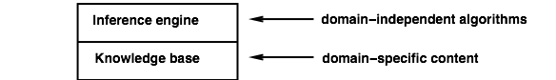
Knowledge bases
Knowledge base =set of sentences in a formal language
Declarative approach to building an agent(or other system):
TELL it what it needs to know
Then it can ASK itself what to do—answers should follow from the KB
推理变成一个“机械”的自动过程。

Slide 7
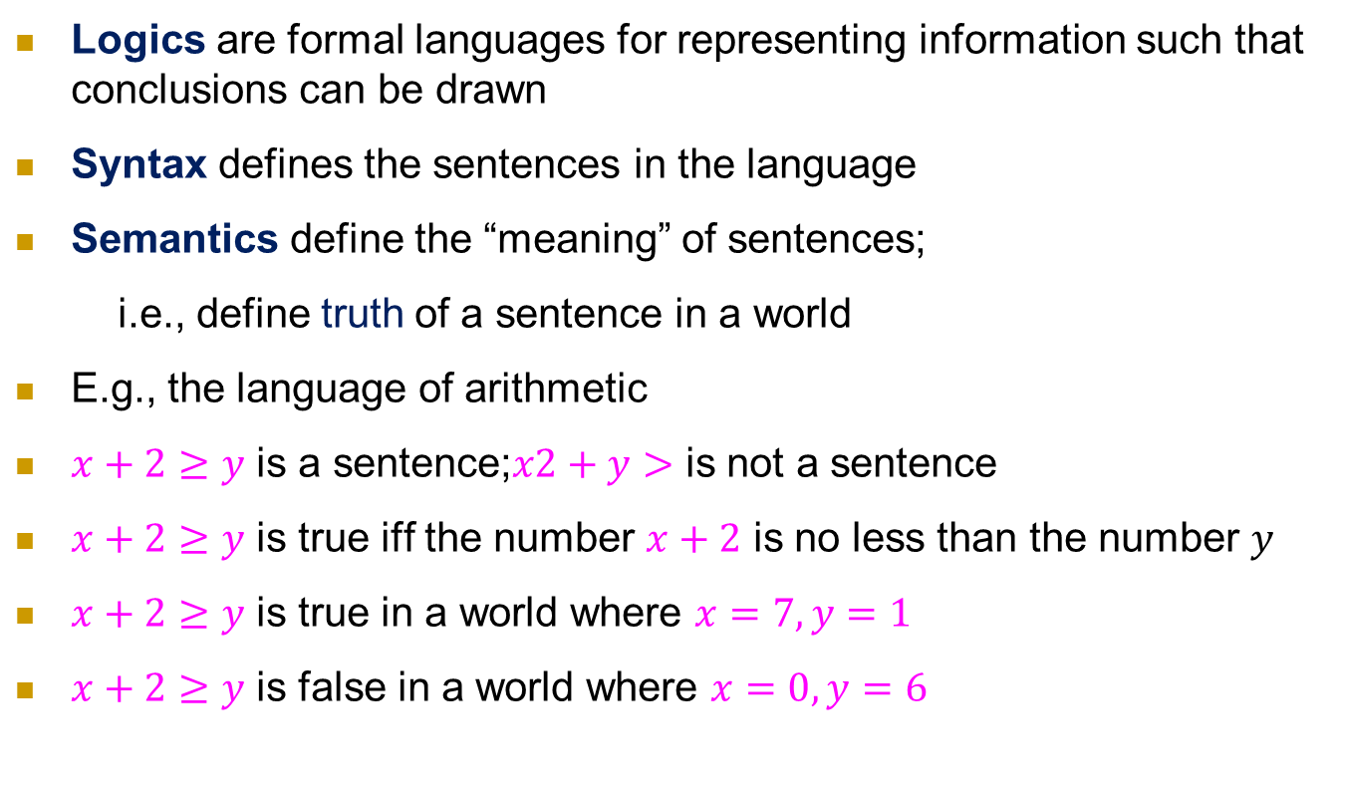
Logic in general
Logics are formal languages for representing information such that conclusions can be drawn
Syntax defines the sentences in the language
Semantics define the “meaning” of sentences;
i.e., define truth of a sentence in a world
E.g., the language of arithmetic
$x+2≥y$ is a sentence;$x2+y>$ is not a sentence
$x+2≥y$ is true iff the number $x+2$ is no less than the number $y$
$x+2≥y$ is true in a world where $x=7,y=1$
$x+2≥y$ is false in a world where $x=0,y=6$

Slide 8
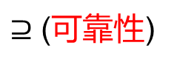
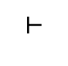
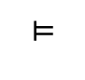
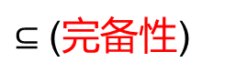
逻辑研究的内容
研究形式化定义的sentences之间的关系
两个角度：
语义：entailment 蕴含，逻辑推导
语法：inference 演绎，形式推演
知识库
（sentences的集合，每个sentence符合
形式逻辑规定的语法）
$$⊨$$
$$⊢$$
新的知识库
（sentences的集合，语义上蕴含）
$⊆$ (完备性)
新的知识库
（sentences的集合，语法上推演）
$⊇$ (可靠性)

Slide 9
语义 Entailment （一般的定义） 什么是“正确的推理”？

Slide 10
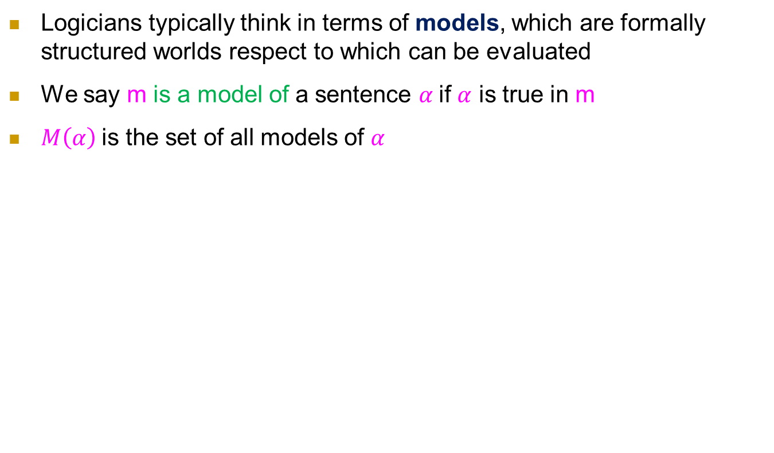
Model (模型), Truth Assignment (真值指派)
Logicians typically think in terms of models, which are formally structured worlds respect to which can be evaluated
We say m is a model of a sentence $α$if $α$ is true in m
$M\left(α\right)$is the set of all models of $α$
X+Y=4
X=0,Y=4是这个句子的model

Slide 11
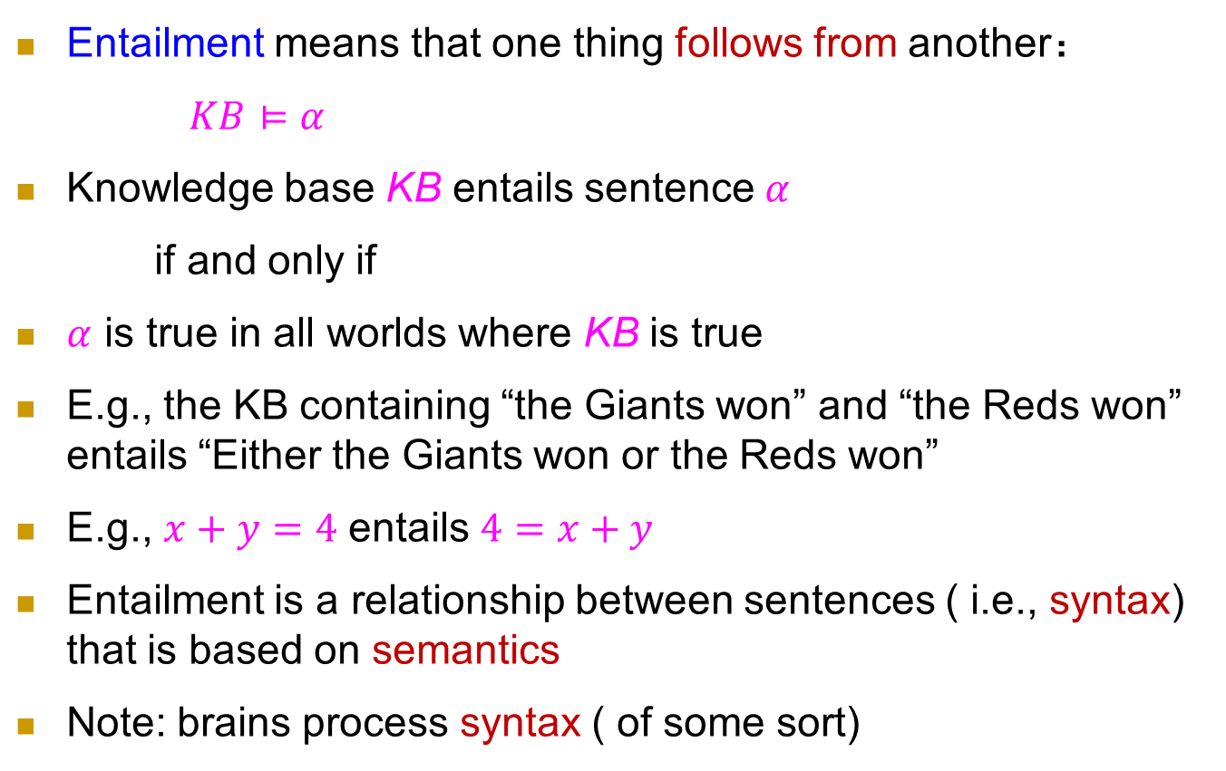
Entailment (蕴涵／蕴含)
语义：逻辑推导
Entailment means that one thing follows from another：
$KB⊨α$
Knowledge base KB entails sentence $α$
if and only if
$α$ is true in all worlds where KB is true
E.g., the KB containing “the Giants won” and “the Reds won” entails “Either the Giants won or the Reds won”
E.g., $x+y=4$ entails $4=x+y$
Entailment is a relationship between sentences ( i.e., syntax) that is based on semantics
Note: brains process syntax ( of some sort)

Slide 12
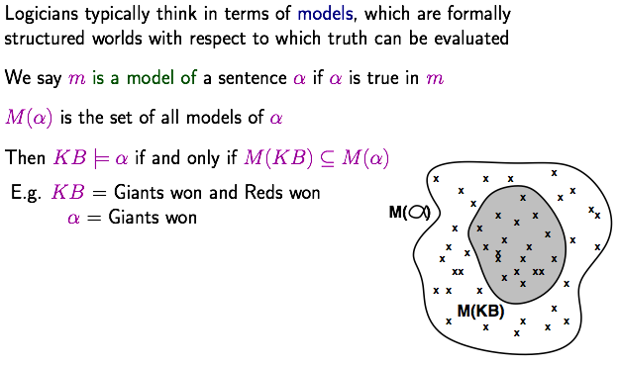
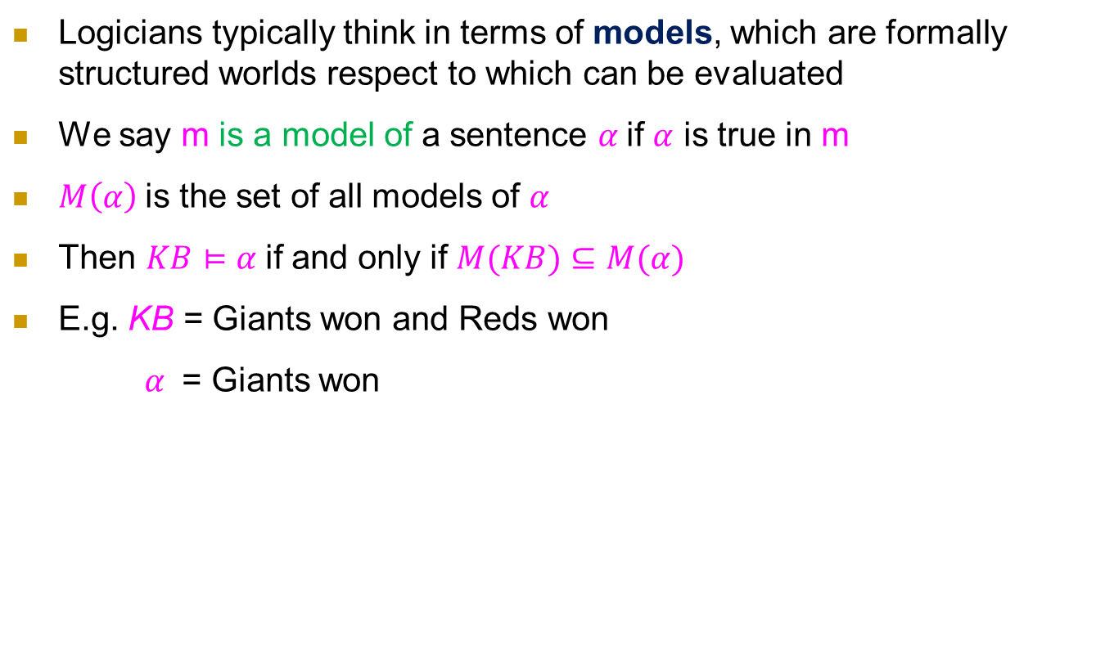
Model (模型)
Logicians typically think in terms of models, which are formally structured worlds respect to which can be evaluated
We say m is a model of a sentence $α$if $α$ is true in m
$M\left(α\right)$is the set of all models of $α$
Then $KB⊨α$if and only if $M(KB)⊆M(α)$
E.g. KB = Giants won and Reds won
$α$ = Giants won
Formal proof

Slide 13
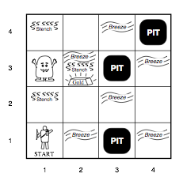
Wumpus World PEAS description
Performance measure
Gold +1000, death -1000
-1 per step, -10 for using the arrow
Environment
Squares adjacent to Wumpus are smelly
Squares adjacent to are breezy
Glitter iff gold is in the same square
Shooting kills Wumpus if you are facing it
Shooting uses up the only arrow
Grabbing picks up gold if in same square
Releasing drops the gold in same square
Sensors Breeze, Glitter, Smell
Actuators
Forward, Grab, Release, Shoot, Left turn, Right turn

Slide 14
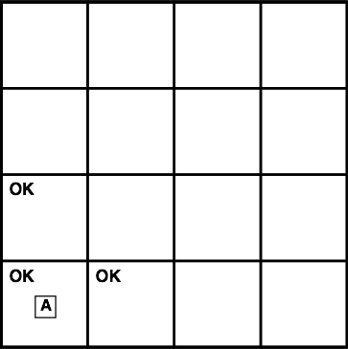
Exploring a wumpus world

Slide 15
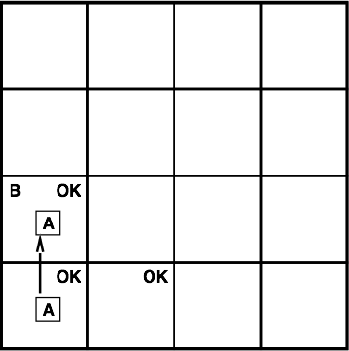
Exploring a wumpus world

Slide 16

Exploring a wumpus world

Slide 17
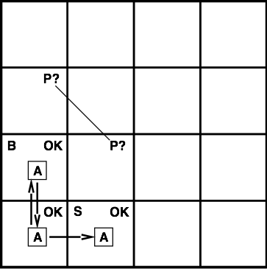
Exploring a wumpus world

Slide 18
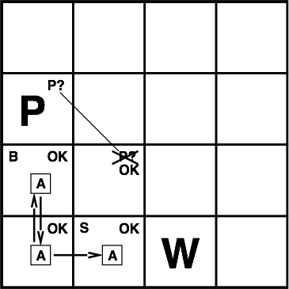
Exploring a wumpus world

Slide 19
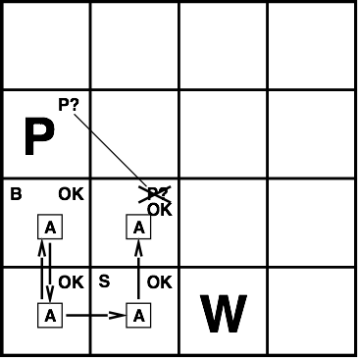
Exploring a wumpus world

Slide 20
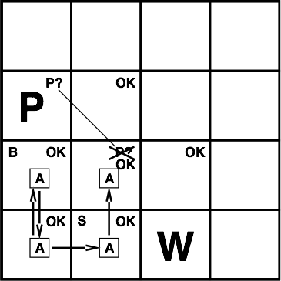
Exploring a wumpus world

Slide 21
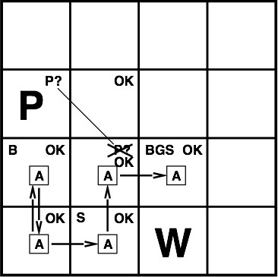
Exploring a wumpus world

Slide 22
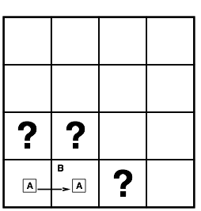
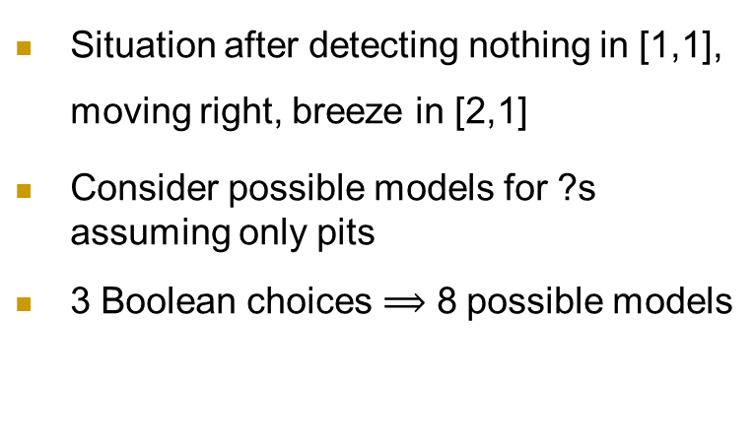
Entailment in the wumpus world
Situation after detecting nothing in [1,1], moving right, breeze in [2,1]
Consider possible models for ?s assuming only pits
3 Boolean choices $⟹$ 8 possible models

Slide 23
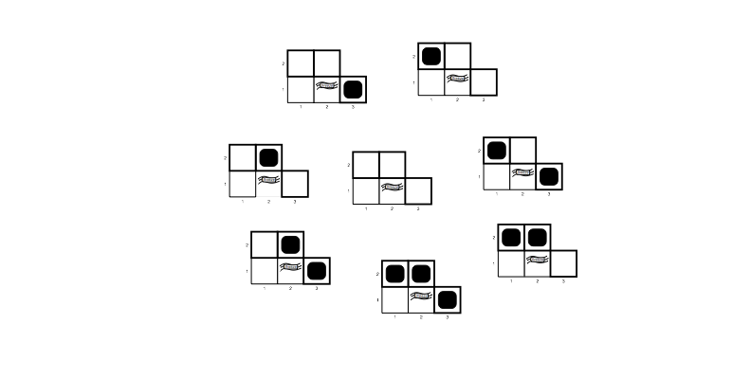
Wumpus models

Slide 24
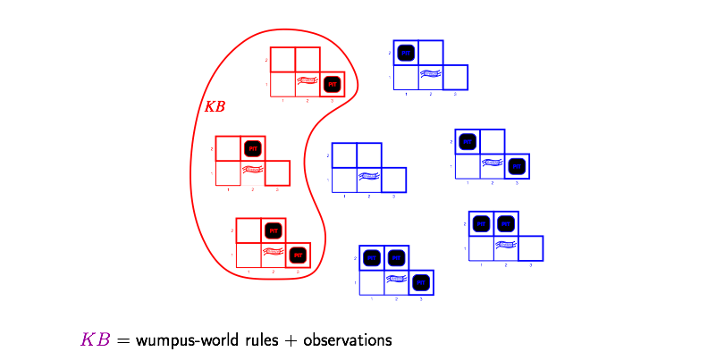
Wumpus models
$KB=$ Wumpus-world rules + observations （[2,1]有风）

Slide 25
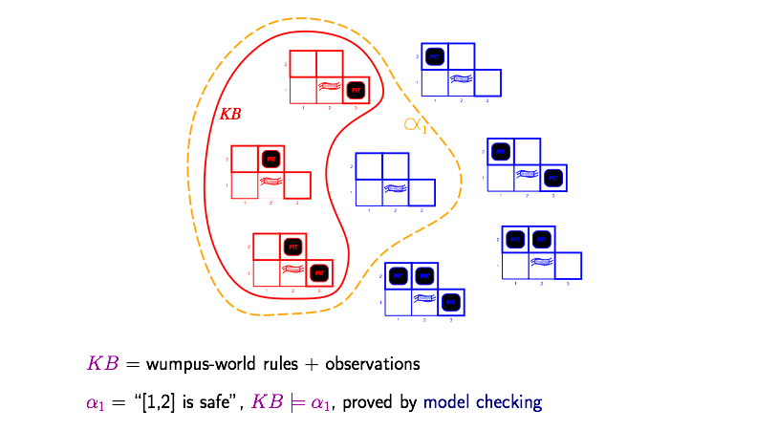
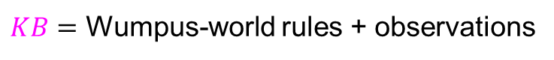
Wumpus models
$KB=$ Wumpus-world rules + observations
$α_{1}=$“[1,2] is not pit”, $KB⊨α_{1}$, proved by model checking

Slide 26
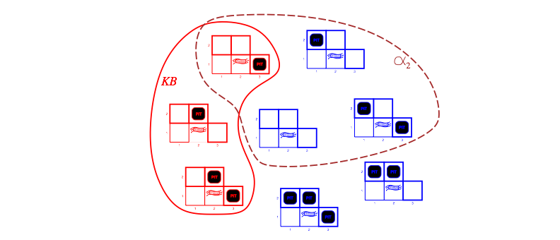
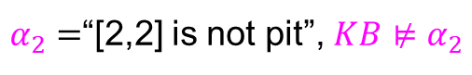
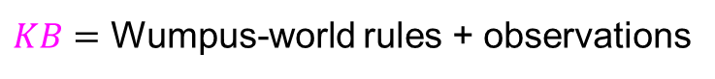
Wumpus models
$KB=$ Wumpus-world rules + observations
$α_{2}=$“[2,2] is not pit”, $KB⊭α_{2}$

Slide 27
Propositional logic: syntax and semantics

Slide 28
Propositional logic (命题逻辑): Syntax
Proposition: a declarative sentence that is either true or false
Propositional logic usually does not consider time
If the truth of a proposition varies over time, we call it fluent (“today is Monday”)
Atomic propositions (原子命题) are minimal propositions
Literals (文字) are atomic propositions or their negations

Slide 29
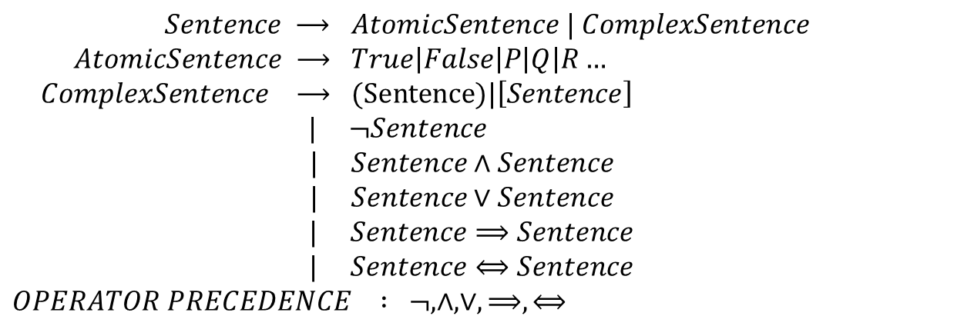
Propositional logic (命题逻辑): Syntax
Defined in Backus-Naur form (BNF)
$$Sentence ⟶ AtomicSentence | ComplexSentence$$
$$AtomicSentence ⟶ True\left|False\right|P\left|Q\right|R…$$
$$ComplexSentence ⟶ (Sentence)|\left[Sentence\right]$$
$$| ¬Sentence$$
$$| Sentence∧Sentence$$
$$| Sentence∨Sentence$$
$$| Sentence⟹Sentence$$
$$| Sentence⟺Sentence$$
$$OPERATOR PRECEDENCE : ¬, ∧,∨,⟹,⟺$$

Slide 30
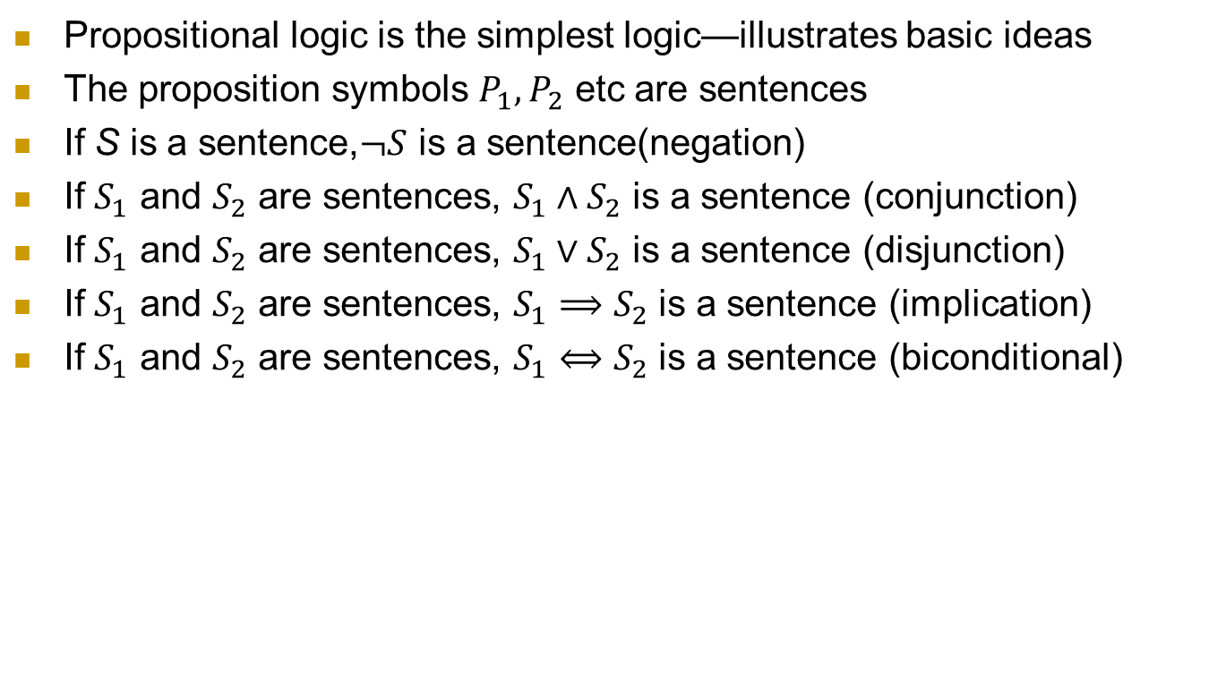
Propositional logic (命题逻辑): Syntax
Propositional logic is the simplest logic—illustrates basic ideas
The proposition symbols $P_{1},P_{2}$ etc are sentences
If S is a sentence,$¬S$ is a sentence(negation)
If $S_{1}$ and $S_{2}$ are sentences, $S_{1}∧S_{2}$ is a sentence (conjunction)
If $S_{1}$ and $S_{2}$ are sentences, $S_{1}∨S_{2}$ is a sentence (disjunction)
If $S_{1}$ and $S_{2}$ are sentences, $S_{1}⟹S_{2}$ is a sentence (implication)
If $S_{1}$ and $S_{2}$ are sentences, $S_{1}⟺S_{2}$ is a sentence (biconditional)

Slide 31
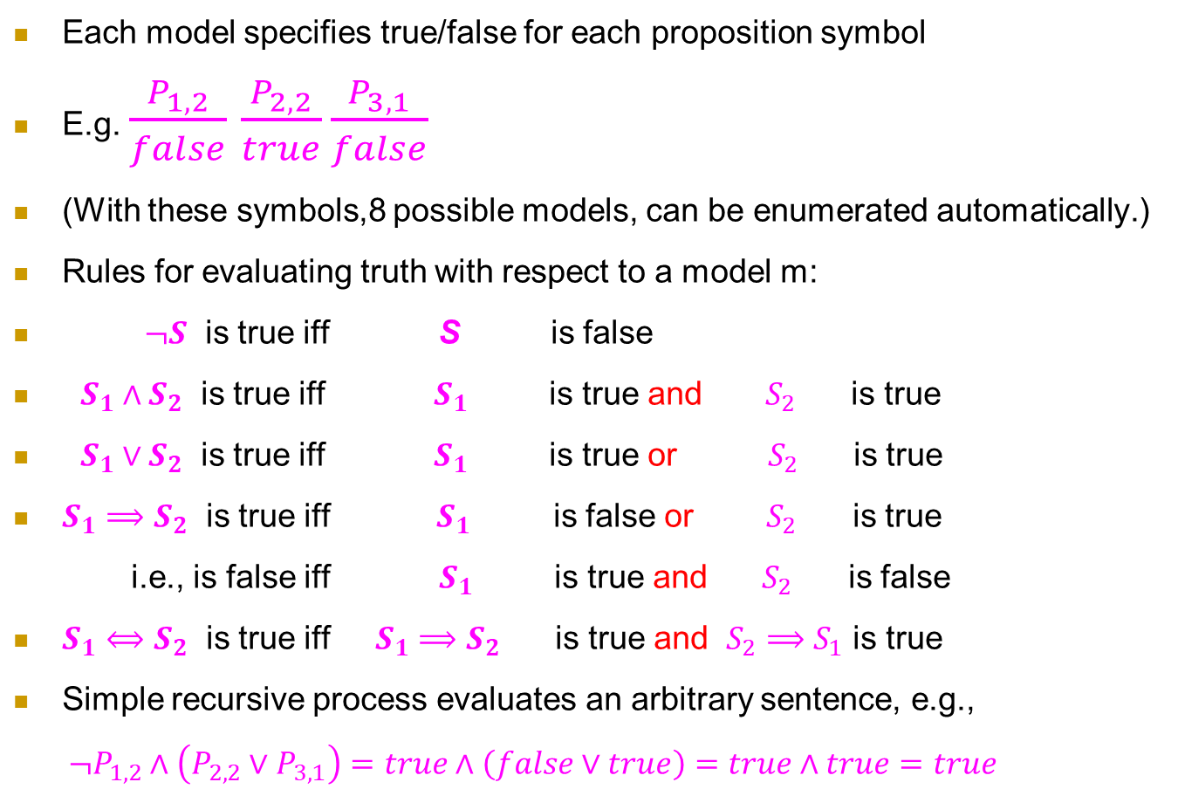
Propositional logic: Semantics
Each model specifies true/false for each proposition symbol
E.g. $\frac{P_{1,2}}{false}$ $\frac{P_{2,2}}{true}\frac{P_{3,1}}{false}$
(With these symbols,8 possible models, can be enumerated automatically.)
Rules for evaluating truth with respect to a model m:
$¬S$ is true iff S is false
$S_{1}∧S_{2}$ is true iff $S_{1}$ is true and $S_{2}$ is true
$S_{1}∨S_{2}$ is true iff $S_{1}$ is true or $S_{2}$ is true
$S_{1}⟹S_{2}$ is true iff $S_{1}$ is false or $S_{2}$ is true
i.e., is false iff $S_{1}$ is true and $S_{2}$ is false
$S_{1}⟺S_{2}$ is true iff $S_{1}⟹S_{2}$ is true and $S_{2}⟹S_{1}$ is true
Simple recursive process evaluates an arbitrary sentence, e.g.,
$¬P_{1,2}∧\left(P_{2,2}∨P_{3,1}\right)=true∧\left(false∨true\right)=true∧true=true$

Slide 32
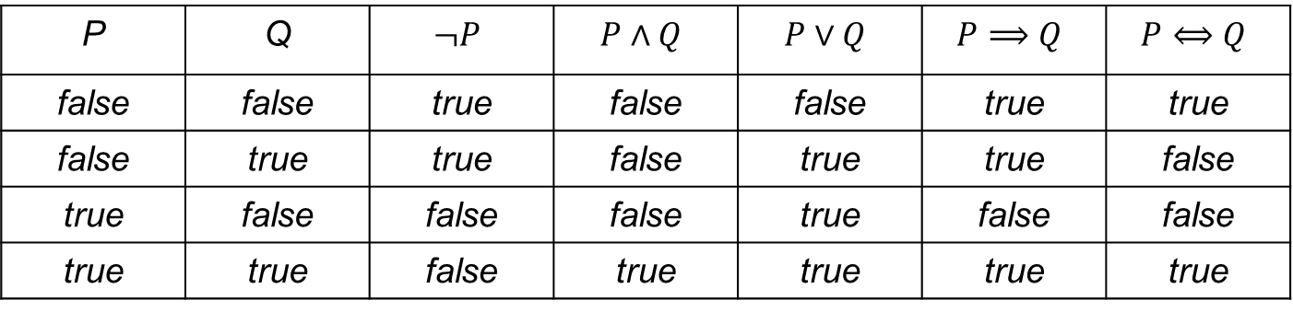


Truth tables for connectives （真值表）
P | Q | $$¬P$$ | $$P∧Q$$ | $$P∨Q$$ | $$P⟹Q$$ | $$P⟺Q$$
false | false | true | false | false | true | true
false | true | true | false | true | true | false
true | false | false | false | true | false | false
true | true | false | true | true | true | true
$∧,∨$ vs. $∩,∪$
区别和联系
$M\left(P∧Q\right)=M\left(P\right)$ $∩M\left(Q\right)$
$$M\left(P∨Q\right)=M\left(P\right)∪M\left(Q\right)$$

Slide 33
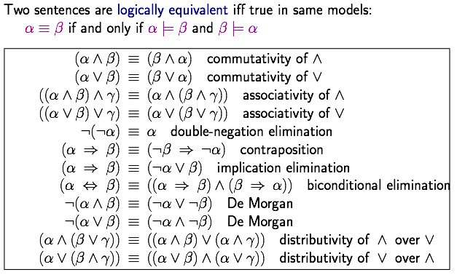
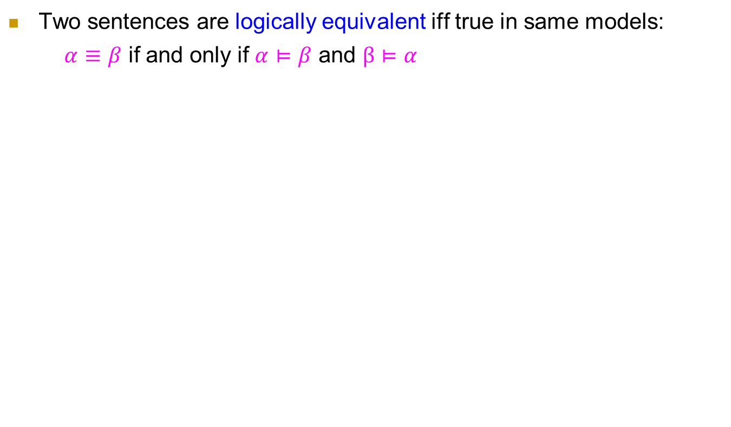
Logical equivalence (语义）
Two sentences are logically equivalent iff true in same models:
$α≡β$ if and only if $α⊨β$ and $β⊨α$
作业

Slide 34
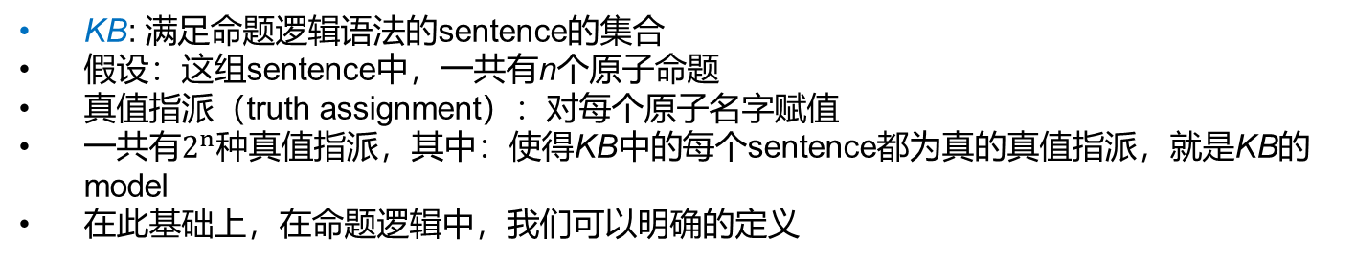
命题逻辑中的知识库KB
KB: 满足命题逻辑语法的sentence的集合
假设：这组sentence中，一共有n个原子命题
真值指派（truth assignment）：对每个原子名字赋值
一共有$2^{n}$种真值指派，其中：使得KB中的每个sentence都为真的真值指派，就是KB的model
在此基础上，在命题逻辑中，我们可以明确的定义

Slide 35
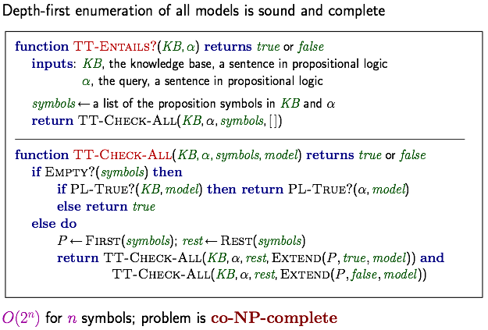
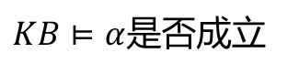
Inference by enumeration
$KB⊨α$是否成立
$$\text{Depth}\text{−}\text{first} \text{enumeration} \text{of} \text{all} \text{models} \text{is} \text{sound} \text{and} \text{complete}$$
$$O\left(2^{n}\right) \text{for} n \text{symbols}\text{; } \text{problem} \text{is} \text{co}\text{−}\text{NP}\text{−}\text{complete}$$

Slide 36
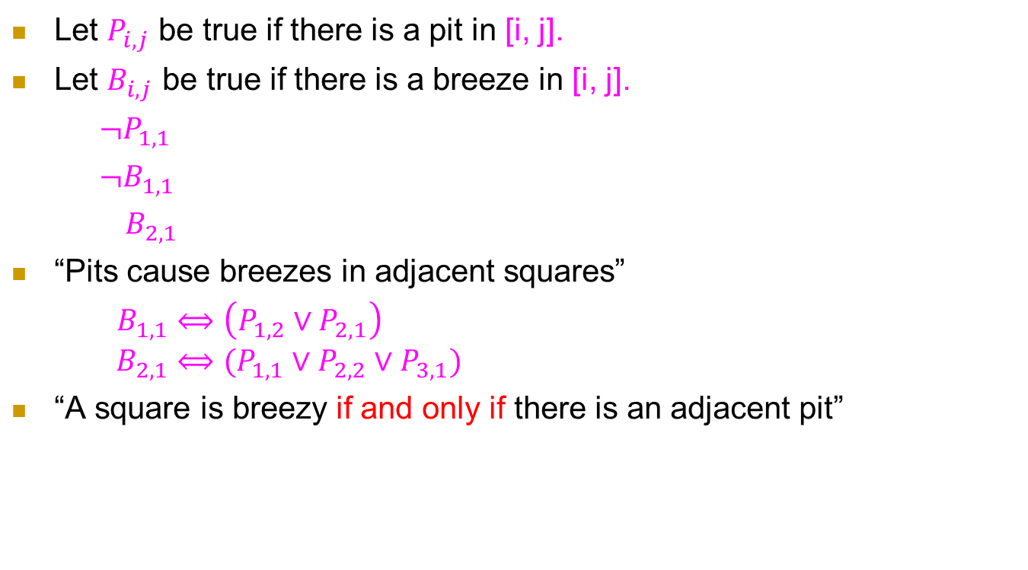
Wumpus world sentences
Let $P_{i,j}$ be true if there is a pit in [i, j].
Let $B_{i,j}$ be true if there is a breeze in [i, j].
$¬P_{1,1}$
$¬B_{1,1}$
$B_{2,1}$
“Pits cause breezes in adjacent squares”
$B_{1,1}⟺\left(P_{1,2}∨P_{2,1}\right)$
$$B_{2,1}⟺(P_{1,1}∨P_{2,2}∨P_{3,1})$$
“A square is breezy if and only if there is an adjacent pit”

Slide 37
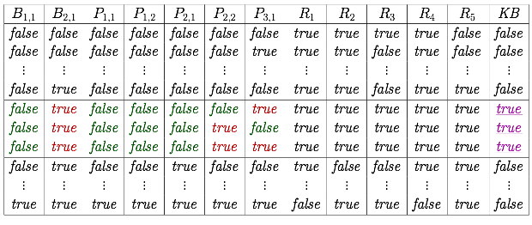
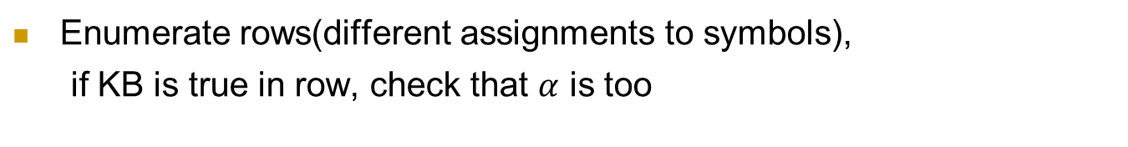
Truth tables for inference
Enumerate rows(different assignments to symbols),
if KB is true in row, check that $α$ is too

Slide 38
Entailment与implication的区别
Entailment: 逻辑上的概念，刻画两组sentence之间的关系
Implication: proposition之间的一种运算子，使用真值表刻画其语义

Slide 39
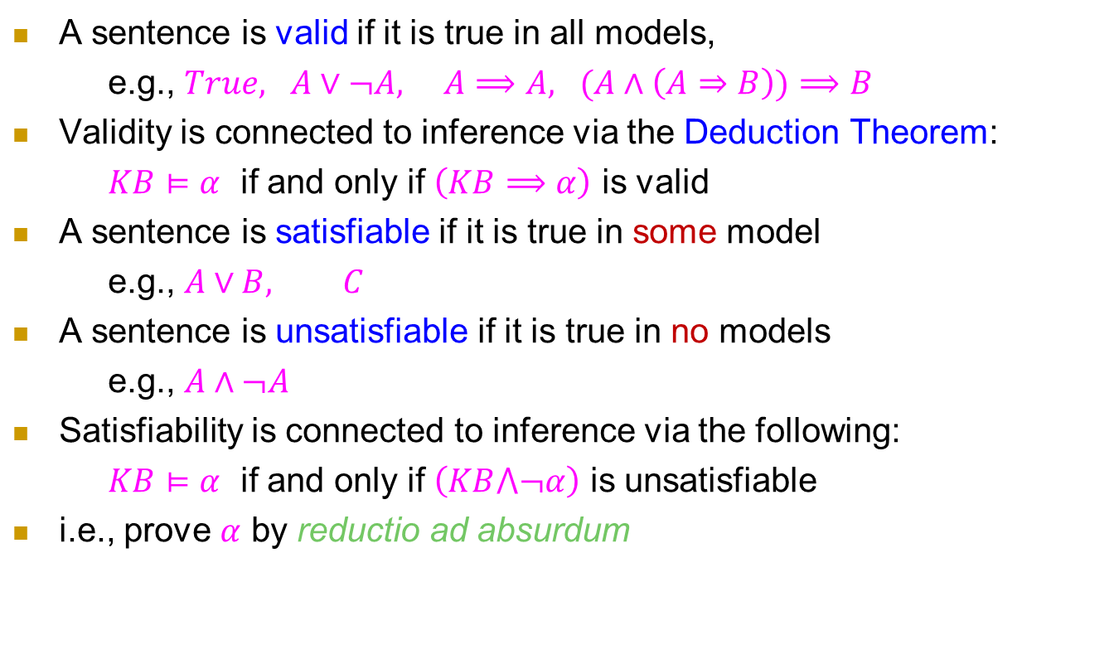
Validity and satisfiability
A sentence is valid if it is true in all models,
e.g., $True, A∨¬A, A⟹A, (A∧\left(A⇒B\right))⟹B$
Validity is connected to inference via the Deduction Theorem:
$KB⊨α$ if and only if $\left(KB⟹α\right)$ is valid
A sentence is satisfiable if it is true in some model
e.g., $A∨B, C$
A sentence is unsatisfiable if it is true in no models
e.g., $A∧¬A$
Satisfiability is connected to inference via the following:
$KB⊨α$ if and only if $\left(KB⋀¬α\right)$ is unsatisfiable
i.e., prove $α$ by reductio ad absurdum

Slide 40
在命题逻辑中运用语义蕴含 奇怪小岛上的逻辑问题

Slide 41
问题1：奇怪小岛上的逻辑问题
Edgar Abercrombie was an anthropologist who was particularly interested in the logic and sociology of lying and truth-telling. One day he decided to visit the Island of Knights and Knaves，in which those called knights always tell the truth and knaves always lie. Furthermore, each inhabitant is either a knight or a knave.
推理问题1：
On the day of his arrival, Abercrombie came across three inhabitants, whom we will call A, B and C.
He asked A: “Are you a knight or a knave?” A answered, but so indistinctly that Abercrombie could not understand what he said. He then asked B: “What did he say?” B replied: “He said that he is a knave.” At this point, C piped up and said: “Don’t believe that; it’s a lie!”
Was C a knight or a knave?
例子来自南京大学陈道蓄教授讲授的《计算机问题求解》课程

Slide 42
问题1：一个很可能的思考过程
假设
A或者是骑士(只说真话)，或者是无赖(只说假话)，二者必居其一。
2. 假如A是骑士，他不可能说自己是无赖，因为那不是事实。
3. 假如A是无赖，也同样不可能说自己是无赖，因为那是真话。
4. 所以，A说的话不可能是“我是无赖”。
5. 因此，B说的不是事实，他必然是无赖。
6. 因此，C说的是事实。
7. 结论：C是骑士。
穷举
反证
A可以是任何人，所以实际上到这里我们就知道这个岛上不会有任何人说自己是无赖。
这个问题太简单，C没说话就可以判定B是knave。

Slide 43
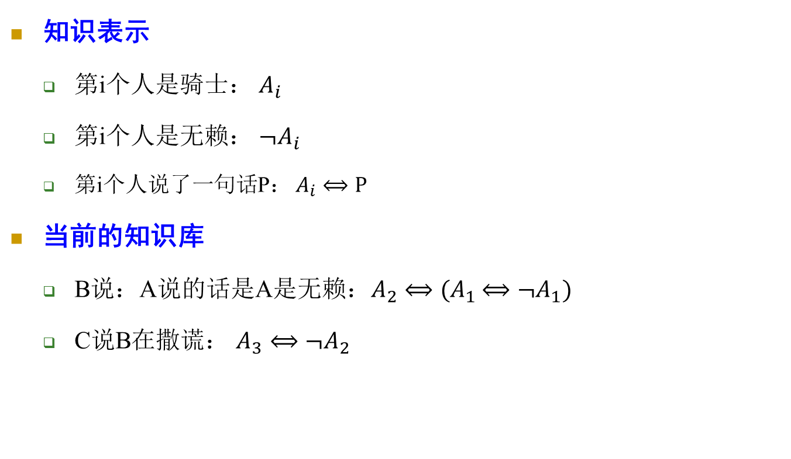
问题1：把思考过程机械化
知识表示
第i个人是骑士： $A_{i}$
第i个人是无赖： ${¬A}_{i}$
第i个人说了一句话P： $A_{i}⟺P$
当前的知识库
B说：A说的话是A是无赖：$A_{2}⟺(A_{1}$ $⟺{¬A}_{1})$
C说B在撒谎： $A_{3}$ $⟺{¬A}_{2}$

Slide 44
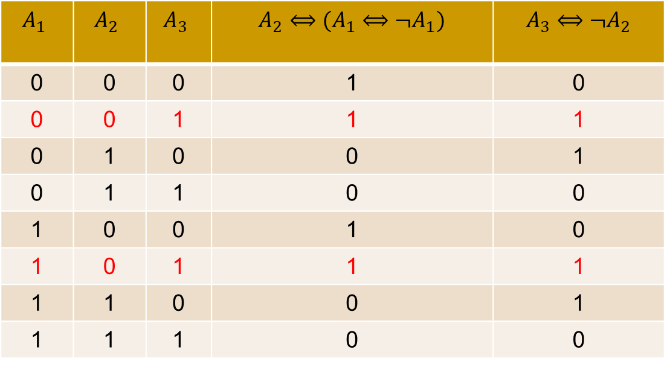
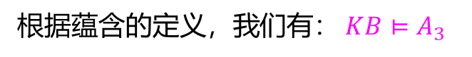
问题1：把思考过程机械化
$$A_{1}$$ | $$A_{2}$$ | $$A_{3}$$ | $A_{2}⟺(A_{1}$ $⟺{¬A}_{1})$ | $A_{3}$ $⟺{¬A}_{2}$
0 | 0 | 0 | 1 | 0
0 | 0 | 1 | 1 | 1
0 | 1 | 0 | 0 | 1
0 | 1 | 1 | 0 | 0
1 | 0 | 0 | 1 | 0
1 | 0 | 1 | 1 | 1
1 | 1 | 0 | 0 | 1
1 | 1 | 1 | 0 | 0
根据蕴含的定义，我们有： $KB⊨A_{3}$

Slide 45
问题2：奇怪小岛上的逻辑问题
Edgar Abercrombie was an anthropologist who was particularly interested in the logic and sociology of lying and truth-telling. One day he decided to visit the Island of Knights and Knaves，in which those called knights always tell the truth and knaves always lie. Furthermore, each inhabitant is either a knight or a knave.
推理问题2
Next, Abercrombie met just two inhabitants, A and B. A made the following statement: “Both of us are knaves.”
What is A and what is B?
例子来自南京大学陈道蓄教授讲授的《计算机问题求解》课程

Slide 46
问题3：奇怪小岛上的逻辑问题
Edgar Abercrombie was an anthropologist who was particularly interested in the logic and sociology of lying and truth-telling. One day he decided to visit the Island of Knights and Knaves，in which those called knights always tell the truth and knaves always lie. Furthermore, each inhabitant is either a knight or a knave.
推理问题3
According to another version of the story, Abercrombie didn’t ask A whether he was a knight or a knave (because he would have known in advance what answer he would get), but instead asked A how many of the three were knaves. Again A answered indistinctly, so Abercrombie asked B what A had said. B then said that A had said that exactly two of them were knaves. Then, as before, C claimed that B was lying.
Is it now possible to determine whether C is a knight or a knave?
例子来自南京大学陈道蓄教授讲授的《计算机问题求解》课程

Slide 47
思考题：怎么用机械化的方法解决问题2和3
步骤一：如何进行知识表示
步骤二：根据蕴含的定义得出结论

Slide 48
形式推演 Deduction

Slide 49
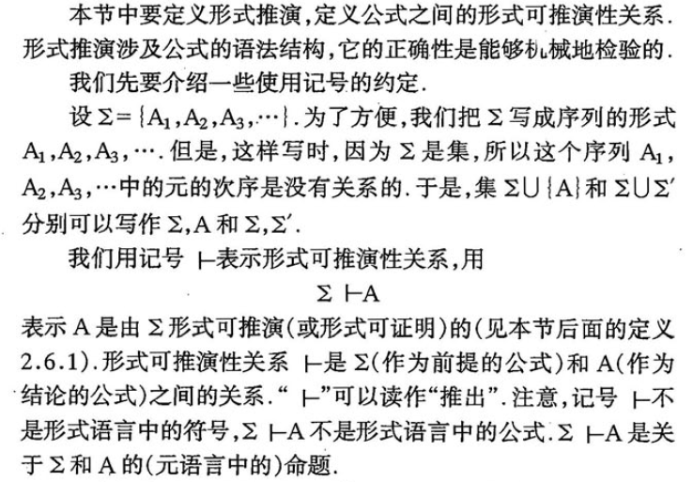
形式推演 Deduction
《面向计算机科学的数理逻辑》49页

Slide 50
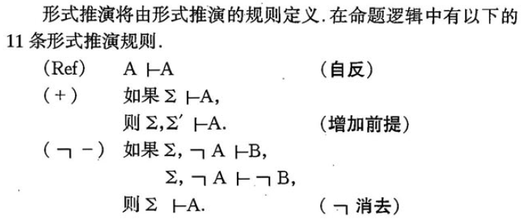
形式推演的11条规则（某一种推演系统）
《面向计算机科学的数理逻辑》49页

Slide 51
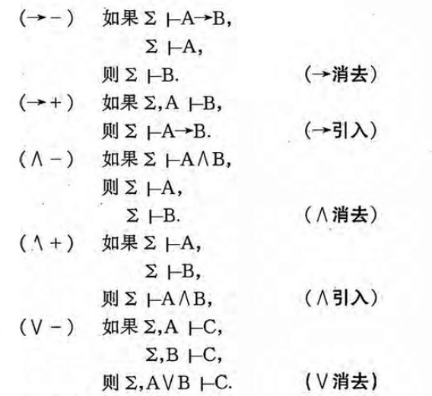

形式推演的11条规则
符号提示：
这里的$→就是$前面定义的$⇒$
《面向计算机科学的数理逻辑》49页

Slide 52


形式推演的11条规则
符号提示：
这里的$↔就是$前面定义的$⇔$
《面向计算机科学的数理逻辑》49页

Slide 53


形式推演
《面向计算机科学的数理逻辑》53页

Slide 54

形式推演：例子
《面向计算机科学的数理逻辑》51页

Slide 55

逻辑推导 vs. 形式推演
《面向计算机科学的数理逻辑》55页

Slide 56

形式推演：例子
Homework：其余题目
《面向计算机科学的数理逻辑》59页

Slide 57

形式推演：例子
Homework：证明这些性质
《面向计算机科学的数理逻辑》63页

Slide 58
形式推演：常用的定理
定理2.6.3, 2.6.4, 2.6.5, 2.6.6, 2.6.7, 2.6.8, 2.6.9, 2.6.10,2.6.11
可以用基本的11条法则证明，它们则可以在其它证明中使用
《面向计算机科学的数理逻辑》

Slide 59



形式推演：Wumpus
$P_{x,y}$ is true if there is a pit in [x,y]
$W_{x,y}$ is true if there is a wumpus in [x,y]
$B_{x,y}$ is true if the agent perceives BREEZE in [x,y]
$B_{x,y}$ is true if the agent perceives STENCH in [x,y]
证明：$KB⊢¬P_{1,2}∧¬P_{2,1}$

Slide 60

形式推演：Wumpus
$$\text{Biconditional} \text{elimination} \text{from} R_{2}$$
$$R_{6}:\left(B_{1,1}⇒\left(P_{1.2}∨P_{2,1}\right)\right)∧\left(\left(P_{1,2}∨P_{2,1}\right)⇒B_{1,1}\right)$$
$$\text{And}−\text{elimination} \text{from} R_{6}$$
$$R_{7}:\left(P_{1,2}∨P_{2,1}\right)⇒B_{1,1}$$
$$\text{Contrapositive} \text{from} R_{7} \text{. }$$
$$R_{8}:¬B_{1,1}⇒¬\left(P_{1,2}∨P_{2,1}\right)$$
$$\text{Modus} \text{Ponens} \text{from} R_{8} \text{. }$$
$$R_{9}:¬\left(P_{1,2}∨P_{2,1}\right)$$
De Morgan‘s rule from $R_{9}$
$$R_{10}:¬P_{1,2}∧¬P_{2,1}$$
证明：$KB⊢¬P_{1,2}∧¬P_{2,1}$
证明过程并不是一个机械化的方法

Slide 61
Summary
逻辑系统
Syntax：formal structure of sentences
Semantics: truth of sentences wrt models; Entailment: necessary truth of one sentence given another
Deduction: formal deduction based on deduction rules

Slide 62


Inference
$$KB⊢_{i}α= \text{sentence} α \text{can} \text{be} \text{derived} \text{from} KB \text{by} \text{procedure} i$$
$$\text{Consequences} \text{of} KB \text{are} \text{a} \text{haystack}\text{; }α \text{is} \text{a} \text{needle}\text{. }$$
$$\text{Entailment} = \text{needle} \text{in} \text{haystack}\text{; }\text{inference} = \text{finding} \text{it}$$
$$\text{Soundness}\text{: }i \text{is} \text{sound} \text{if}$$
$$\text{whenever} KB⊢_{i}α, \text{it} \text{is} \text{also} \text{true} \text{that} KB⊨α$$
$$\text{Completeness}\text{: }i \text{is} \text{complete} \text{if}$$
$$\text{whenever} KB⊨α, \text{it} \text{is} \text{also} \text{true} \text{that} KB⊢_{i}α$$
$$\text{Preview}\text{: }\text{we} \text{will} \text{define} \text{a} \text{logic}\text{ (}\text{first}\text{−}\text{order} \text{logic}\text{) }\text{which} \text{is} \text{expressive} \text{enough} \text{to} \text{say} \text{almost} \text{anything} \text{of} \text{interest}\text{, }\text{and} \text{for} \text{which} \text{there} \text{exists} \text{a} \text{sound} \text{and} \text{complete} \text{inference} \text{procedure}\text{.}$$
$$\text{That} \text{is}\text{, }\text{the} \text{procedure} \text{will} \text{answer} \text{any} \text{question} \text{whose} \text{answer} \text{follows} \text{from} \text{what} \text{is} \text{known} \text{by} \text{the} \text{KB}\text{.}$$
哥德尔不完全 定理：在一个大的范围内（证明法和问题与正整数存在一一对应关系），不存在既sound又complete的inference过程

